Slide 1
Taking Control of Your Academic Identity
Author: Laura Bredahl (She/Her)
Bibliometrics and Research Impact Librarian
Laura.Bredahl@uwaterloo.ca
https://orcid.org/0000-0002-9397-0764

Slide 2
Land Acknowledgement
The creators of this slide deck respectfully acknowledge that we live, work, and learn on lands of the Haldimand Treaty of 1784, a formally ratified agreement promising the land in perpetuity to the Six Nations of the Grand River and is within the territory traditionally cared for by the Neutral, Anishinaabe, and Haudenosaunee peoples.
This acknowledgement is a small step to challenge colonialism and honour the enduring presence, achievements, and contributions of First Nations, Inuit, and Métis peoples.​

Slide 3
Table of contents
Title page
page 1
Land Acknowledgement
page 2
What is my Academic Identity?
page 4
Introducing ORCID
page 5
How it connects
page 6
Author search in Scopus
page 7
ORCID profile
page 8
What can I do?
page 9
Step 1: Register with ORCID
page 10
Step 2: Sign up with ORCID
page 11
Step 3: Fill out your profile
page 12
Step 4: Connect with other platforms
page 13
Step 5 Share it, use it
page 14
Wrap up
page 15
Credits and Licensing
page 16

Slide 4
What Is My Academic Identity?

Slide 5
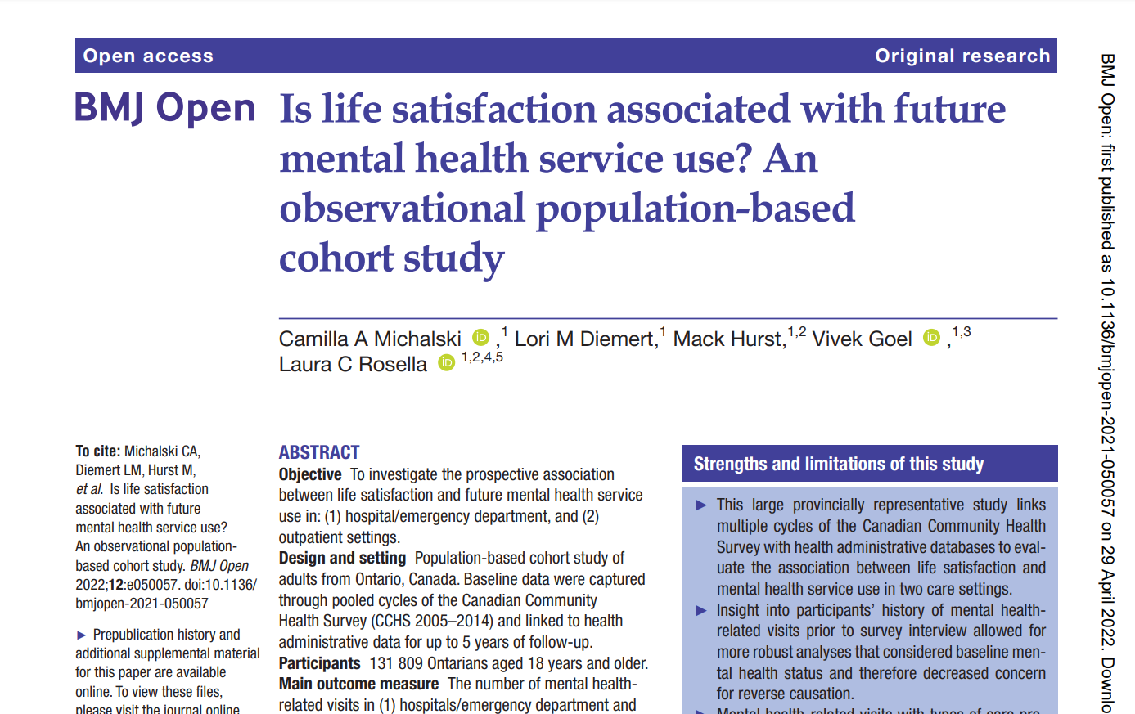
Introducing ORCID
ORCID is a global non-profit organization that provides Open Researcher and Contributor (ORCID) IDs to researchers.
The result of publishing articles is that you, as an author, appear in various journals.
For example, on the right-hand side, we can see an article page from the BMJ Open online journal listing Vivek Goel, the University of Waterloo President and Vice-Chancellor in 2022, as a co-author and his ORCID ID icon beside his name.

Slide 6
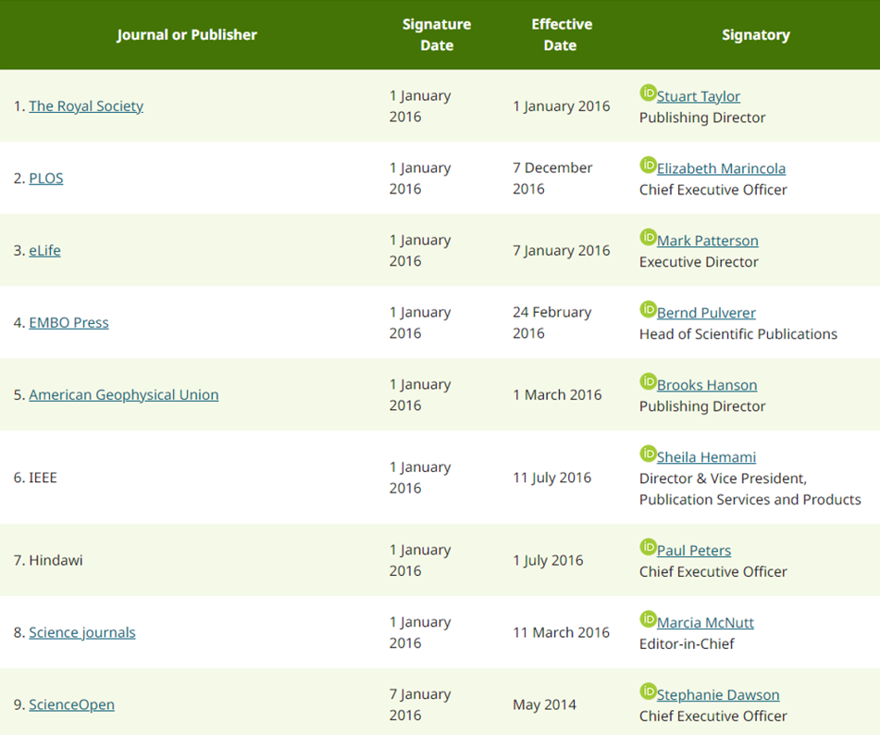
How it connects
The initial stage in publishing is the manuscript submission process.
For example, on the Optometry and Vision Science journal page, a journal that integrates with ORCID, use the My ORCID Record tab to register and submit your manuscript.
This is a growing list of publishers’ that work with ORCID, streamlining the submission process and making it easier to update your ORCID upon publication.

Slide 7
ORCID Helps to Disambiguate Authors
This is the search results from an author search in the Scopus database:
Searching for Vivek Goel, we can determine that the first author listed, with 152 documents, is the University of Waterloo’s President, Vivek Goel.
What about the others? Are they the same Vivek Goel?
ORCID ID helps to disambiguate by distinguishing researchers with the same or similar names.

Slide 8
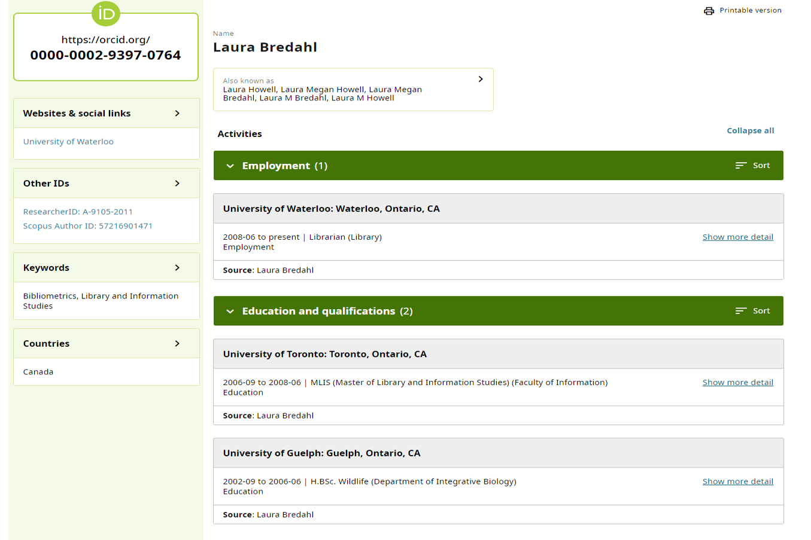
ORCID profile information
ORCID profiles are helpful because they allow you, as a researcher, to accurately attribute yourself to your:
works,
grants,
distinctions,
employment,
affiliated institutions, and
other academic milestones.
This curated list of professional information is easily discoverable by future collaborators, publishers, funders, or employers.

Slide 9
What can I do?

Slide 10
Step 1: Register with ORCID
Register first to create your ORCID ID.
TIP
For email, use your uwaterloo.ca email!

Slide 11
Step 2: Sign up with ORCID
Sign in using your 16-digit ORCID ID.
TIP
Sign in with Uwaterloo’s single sign-on! This allows you to link your ORCID account to your University’s account.

Slide 12
Step 3: Fill out your profile
Enhance your ORCID record with your professional information.
Name
Name variants
Education
Employment
Funding/Grants
Invited position/Distinctions
Service

Slide 13
Step 4: Connect with other platforms
Link to your other identifiers to automatically update your ORCID record.
Tip
Use the ORCID Search & Link Wizard, or Trusted Parties to connect platforms.
Consult this Research guide for more details.

Slide 14
Step 5: Share it, use it
Add your ORCID ID when you submit manuscripts and in the research workflow to get credit.
Email signatures
Grant submissions
Manuscript submissions
Export data to Bibtex to connect to reference managers, etc.
Add a trusted user to manage your record for you!

Slide 15
Wrap up
ORCID will give you control over your identity! The only way to ensure that your publications are listed as your own is by creating an author profile such as ORCID. It is a widely used academic identification system that allows you to efficiently control your author identity.
Why have an ORCID ID?
Disambiguates authors with similar, different variations or changed names.
Helps researchers get credit for your work.
It is a researcher-controlled account with privacy settings.
ID follows the researcher throughout their career.
Allows researchers to create and organize a virtual publication list.
Permits researchers to better link their works together.
Integrates with many publication and grant application programs.
Shared in email signatures and reference management software as BibTeX.

Slide 16
Credits and Licensing
Content Creator: Alissa Droog, Laura Bredahl
Instructional Designer: Stefaniada Voichita, Kari D. Weaver
Additional feedback was generously contributed by Megan Palmer, Kari D. Weaver.
This presentation is licensed under a Creative Commons 4.0 Attribution-Non Commercial License (CC 4.0 BY-NC).
Attribution may be indicated as follows: Droog, A., Bredahl, L., Weaver, K. D., Palmer, M., Voichita, S. (2022). Taking Control of Your Academic Identity. University of Waterloo Library. Link to repository. Used under CC 4.0 BY-NC.
For more information, please email laura.bredahl@uwaterloo.ca.

